Slide 1
watir-webdriver

Slide 2

Who am I?
Norway’s largest online marketplace
900 million page views / month
4 million unique users / month

Slide 3

Who am I?
watir celerity
selenium-webdriver watir-webdriver

Slide 4
Who am I?
watir celerity
selenium-webdriver watir-webdriver

Slide 5
Who am I?
vnctools
childprocess
har
fﬁ-icu
fﬁ-sybase
webidl bamboo-client
jstd-runner
cuketagger
cukeforker

Slide 6
Who am I?
http://github.com/jarib
@jarib

Slide 7
Ruby?
Selenium RC?
WebDriver?
Watir?
Watir-WebDriver?
Capybara?

Slide 8
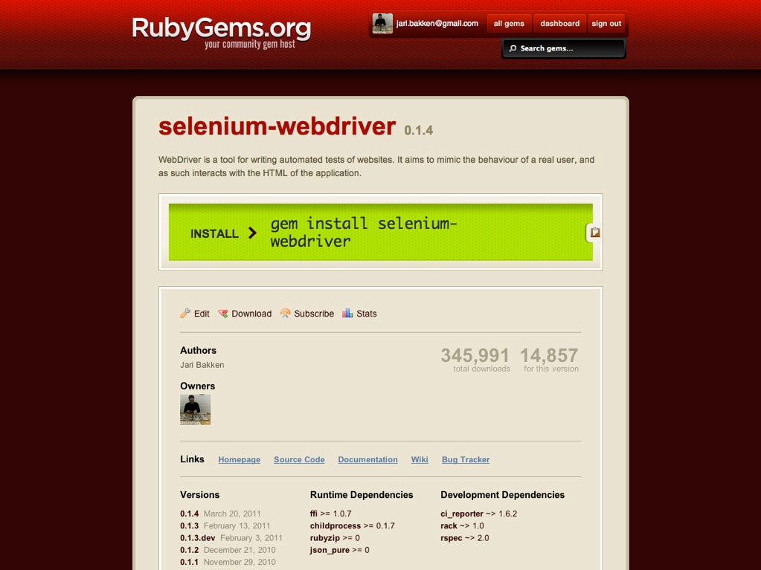

Slide 9
selenium-webdriver
Ofﬁcial gem for Selenium 2
Slightly Rubyﬁed version of the WebDriver API
Also includes the RC API (selenium-client gem no longer maintained)
•
•
https://rubygems.org/gems/selenium-webdriver http://selenium.googlecode.com

Slide 10
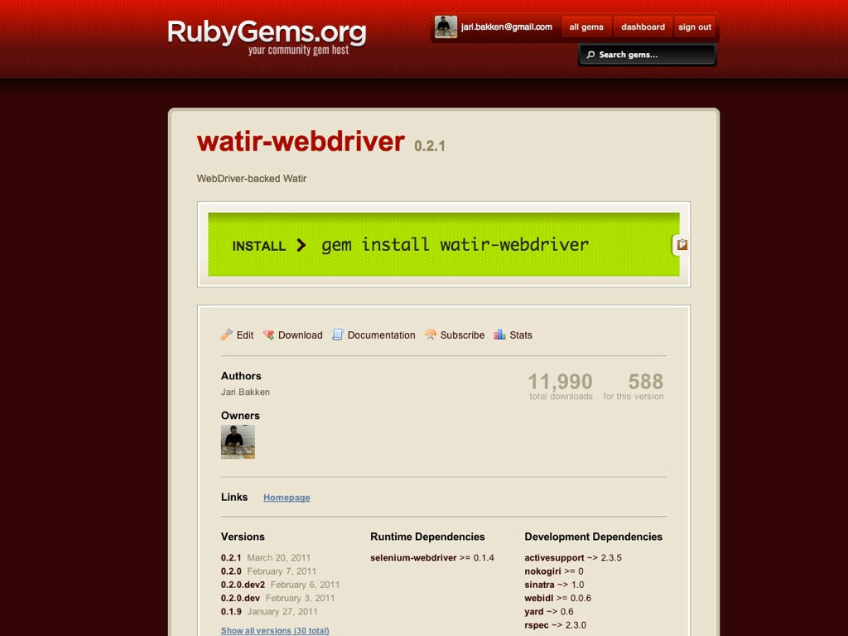

Slide 11
watir-webdriver
Wraps selenium-webdriver in higher level API
https://rubygems.org/gems/watir-webdriver
https://github.com/jarib/watir-webdriver

Slide 12
Example

Slide 13
require 'selenium-webdriver'
driver = Selenium::WebDriver.for :firefox
driver.get "http://translate.google.com/"
wait = Selenium::WebDriver::Wait.new(:timeout => 5)
# wait for the language button to be displayed
language_button = wait.until {
element = driver.find_element(:id => "gt-sl-gms") element if element.displayed?
}
# click the first div to open the menu
language_button.find_element(:tag_name
=> "div").click
# wait for the menu
menu = wait.until {
element = driver.find_element(:id => element if element.displayed?
}
"gt-sl-gms-menu")
https://gist.github.com/902119
# fetch
langs =
menu items
menu.find_elements(:class => "goog-menuitem")
# click a language
norwegian = langs.find { |lang| lang.text == "Norwegian" } norwegian.find_element(:tag_name => "div").click
# print the chosen language
puts language_button.text
# set a string to translate
driver.find_element(:id => "source").send_keys("ost")
# wait for the result
result = result result
}
wait.until {
= driver.find_element(:id => "result_box").text
if result.length > 0
puts result driver.quit

Slide 14
require
'selenium-webdriver'
driver =
Selenium::WebDriver.for :firefox
driver.get "http://translate.google.com/"

Slide 15
wait
= Selenium::WebDriver::Wait.new(:timeout
=> 5)
# wait for the language button to
language_button = wait.until {
be displayed
element =
element
driver.find_element(:id
=> "gt-sl-gms")
if element.displayed?
}

Slide 16
# click the first div to open the menu
language_button.find_element(:tag_name
# wait for the menu
menu = wait.until {
element = driver.find_element(:id => element if element.displayed?
=> "div").click
"gt-sl-gms-menu")
}

Slide 17
# fetch | menu items
langs = | menu.find_elements(:class | => | "goog-menuitem")
# click a language
norwegian = langs.find { |lang|
lang.text
== "Norwegian" }
norwegian.find_element(:tag_name
# print the chosen language
puts language_button.text
=> "div").click

Slide 18
# set a string to translate
driver.find_element(:id => "source").send_keys("ost")
# wait | for the result
result | = wait.until {
text | = driver.find_element(:id | => | "result_box").text
text | if text.length > 0
}
puts result driver.quit

Slide 19
selenium-webdriver
require
'selenium-webdriver'
driver =
Selenium::WebDriver.for :firefox
driver.get "http://translate.google.com/"
watir-webdriver
require
'watir-webdriver'
browser =
Watir::Browser.new :firefox
browser.goto
"http://translate.google.com/"

Slide 20
selenium-webdriver
wait =
Selenium::WebDriver::Wait.new(:timeout
=> 5)
language_button = wait.until {
element =
element
driver.find_element(:id
=> "gt-sl-gms")
if element.displayed?
}
language_button.find_element(:tag_name
=> "div").click
watir-webdriver
language_button = browser.span(:id => "gt-sl-gms") language_button.when_present.div.click

Slide 21
selenium-webdriver
menu =
wait.until {
element element
= driver.find_element(:id
=> "gt-sl-gms-menu")
if element.displayed?
}
langs = menu.find_elements(:class
=> "goog-menuitem")
norwegian = langs.find { |lang| lang.text
== "Norwegian" }
norwegian.find_element(:tag_name =>
watir-webdriver
"div").click
menu = browser.div(:id => "gt-sl-gms-menu") menu.when_present.div(
).div.click
:class | => | "goog-menuitem",
:text | => | "Norwegian"

Slide 22
selenium-webdriver
driver.find_element(:id
=> "source").send_keys("ost")
result | = | wait.until {
text | = | driver.find_element(:id | => | "result_box").text
text | if | text.length > 0
}
puts result driver.quit
watir-webdriver
browser.text_field(:id
=> "source").set("ost")
result_box = browser.span(:id
=> "result_box")
browser.wait_until { result_box.text.length > 0 }
puts result_box.text browser.close

Slide 23
https://gist.github.com/902125

Slide 24
selenium-webdriver
>> | driver.find_element(:id => "country")
=> | #<Selenium::WebDriver::Element:0x..fa93ee | tag_name="select">
watir-webdriver
>> | browser.select_list(:id => | "country")
=> | #<Watir::Select:0x..fa349d | located=false | selector={:id=>"country", | :t
>> | d.text_field(:name => "user")
=> | #<Watir::TextField:0x..fb63099fd1e2f6130 | located=false | selector={:nam

Slide 25
Voter
turnout:
<meter
id=turnout
value=0.75>75%</meter>
>> meter = |  | browser.meter(:id | => | "turnout")
#=> #<Watir::Meter:0x3ebf128988f2b418 located=false |  |  |  |  | selector={:
>> met | er.value .75 ter.value.class loat
#=> 0
>> me
#=> F

Slide 26
Watir::Anchor Watir::Applet Watir::Area Watir::Audio Watir::BR Watir::Base Watir::BaseFont Watir::Body Watir::Button Watir::Canvas Watir::CheckBox Watir::Command Watir::DList Watir::DataList Watir::Details Watir::Device Watir::Directory Watir::Div Watir::Embed Watir::FieldSet
Watir::FileField Watir::Font Watir::Form Watir::Frame Watir::FrameSet Watir::HR Watir::HTMLElement Watir::Head Watir::Heading Watir::Hidden Watir::Html Watir::IFrame Watir::Image Watir::Input Watir::Keygen Watir::LI Watir::Label Watir::Legend Watir::Map Watir::Marquee
Watir::Media Watir::Menu Watir::Meta Watir::Meter Watir::Mod Watir::OList Watir::Object Watir::OptGroup Watir::Option Watir::Output Watir::Paragraph Watir::Param Watir::Pre Watir::Progress Watir::Quote Watir::Radio Watir::Script Watir::Select Watir::Source Watir::Span
Watir::Style Watir::Table
Watir::TableCaption
Watir::TableCell Watir::TableCol
Watir::TableDataCel
Watir::TableHeaderC
Watir::TableRow
Watir::TableSection
Watir::TextArea Watir::TextField Watir::Time Watir::Title Watir::Track Watir::UList Watir::Unknown Watir::Video

Slide 27
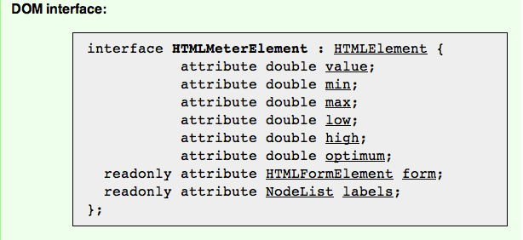
Ruby code generated from the HTML spec
module Watir
class Meter < HTMLElement
attributes(
:float
:html_element
:list
=> [:value,
=> [:form],
=> [:labels]
:min, :max, :low, :high, :optimum],
)
end end

Slide 28
Comparison with Watir 1
https://github.com/jarib/watir-webdriver/wiki/Comparison-with-Watir-1.X
•
Supports all browsers available in WebDriver
•
Firefox, IE, Chrome; HtmlUnit, Opera, iPhone, Android
•
Mostly compatible API-wise. Some major changes:
•
•
•
•
0-indexed instead of 1-indexed
All HTML tags supported (from the HTML5 spec) Revised table API
New window switching API

Slide 29
Exercises
gem install watir-webdriver
Write a test for http://ﬁgureoutwhen.com/ https://gist.github.com/902139
Refactor the Google Translate example into a page object
https://gist.github.com/902125
Use watir-webdriver to test your own app https://gist.github.com/902141

